Slide 1




IBM INTERNSHIP PROJECT

Slide 2

Student details
Name : Ujjwal Yadav
LinkedIn: https://www.linkedin.com/in/ujjwaly/
Email : ujjwalyadav1610@gmail.com
College : KIET GROUP OF INSTITUTIONS, Ghaziabad
Internship domain: Artificial Intelligence
Project name: Mental fitness tracker
Duration: 12th June 2023 – 24th July 2023

Slide 3

Problem statement
Create a mental fitness tracker powered by AI that keeps track of and evaluates users' psychological health. The tracker seeks to provide users the tools they need to build resilience, manage stress, and promote overall mental health.

Slide 4

Agenda
When creating an algorithm Collecting the data first, cleaning it up, preprocessing it, encoding it, and separating it into test and training data Using a data set to train the algorithms, testing them with machine learning tools like decision trees and KNN algorithms, and comparing the results.

Slide 5
Overview of the project
A tool that could track a person's mental fitness over time would be an artificial intelligence-powered mental fitness tracker.
It might analyze a person's behavior and look for patterns that might point to changes in their mental state using algorithms like decision trees and k-nearest neighbors. By offering insights into behavior and making recommendations for methods to enhance mental wellbeing, the gadget may be utilized to assist people in managing their mental health.

Slide 6
Target users
Individuals: People who desire to monitor and advance their mental fitness are the main end users. They may use the mental fitness tracker to keep tabs on their stress levels, mood, and sleeping habits.
Professionals in Mental Health: The mental fitness tracker may be used as an additional tool in the practice of mental health specialists like therapists, psychologists, or counsellors.
Corporate Wellness Programs: Employers and organizations may use the mental fitness tracker in their wellness programs to help promote mental health and wellbeing among their staff members.
Researchers and Academics: The data from the mental fitness tracker may be used for research, analysis, and developments in the fields of mental health and artificial intelligence.

Slide 7
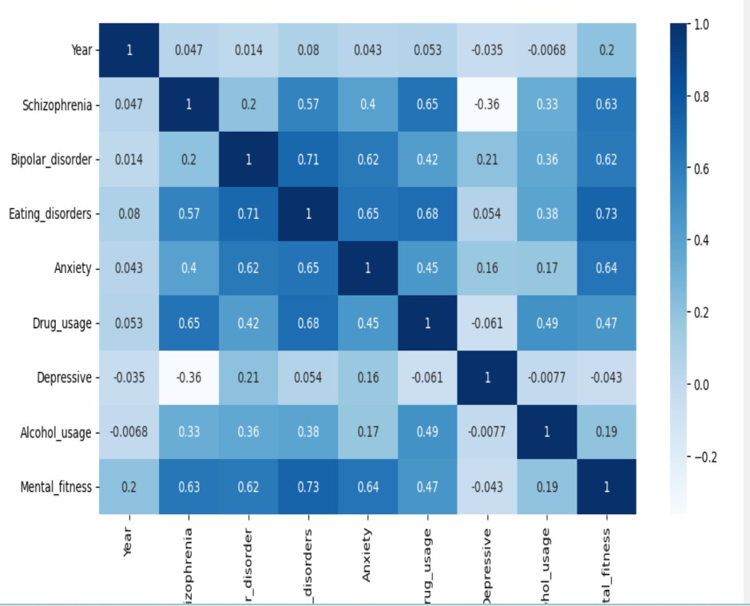
Solution
Solution: Mental Fitness Tracker Using Artificial Intelligence
Value Proposition:
Personalized Insights
Early Detection and Prevention
Goal Setting and Progress Tracking
Personalized Interventions
Insights for Healthcare Professionals
User-Friendly Interface
Privacy and Security

Slide 8

Implementation
I modified the algorithms in the code and utilised the Linear Regression and Random Forest to contrast the algorithms' value.
The Random forest algorithm has produced results with a higher perceived value, making its use advantageous Through studying them, I've gained knowledge of the methods and written the code.

Slide 9
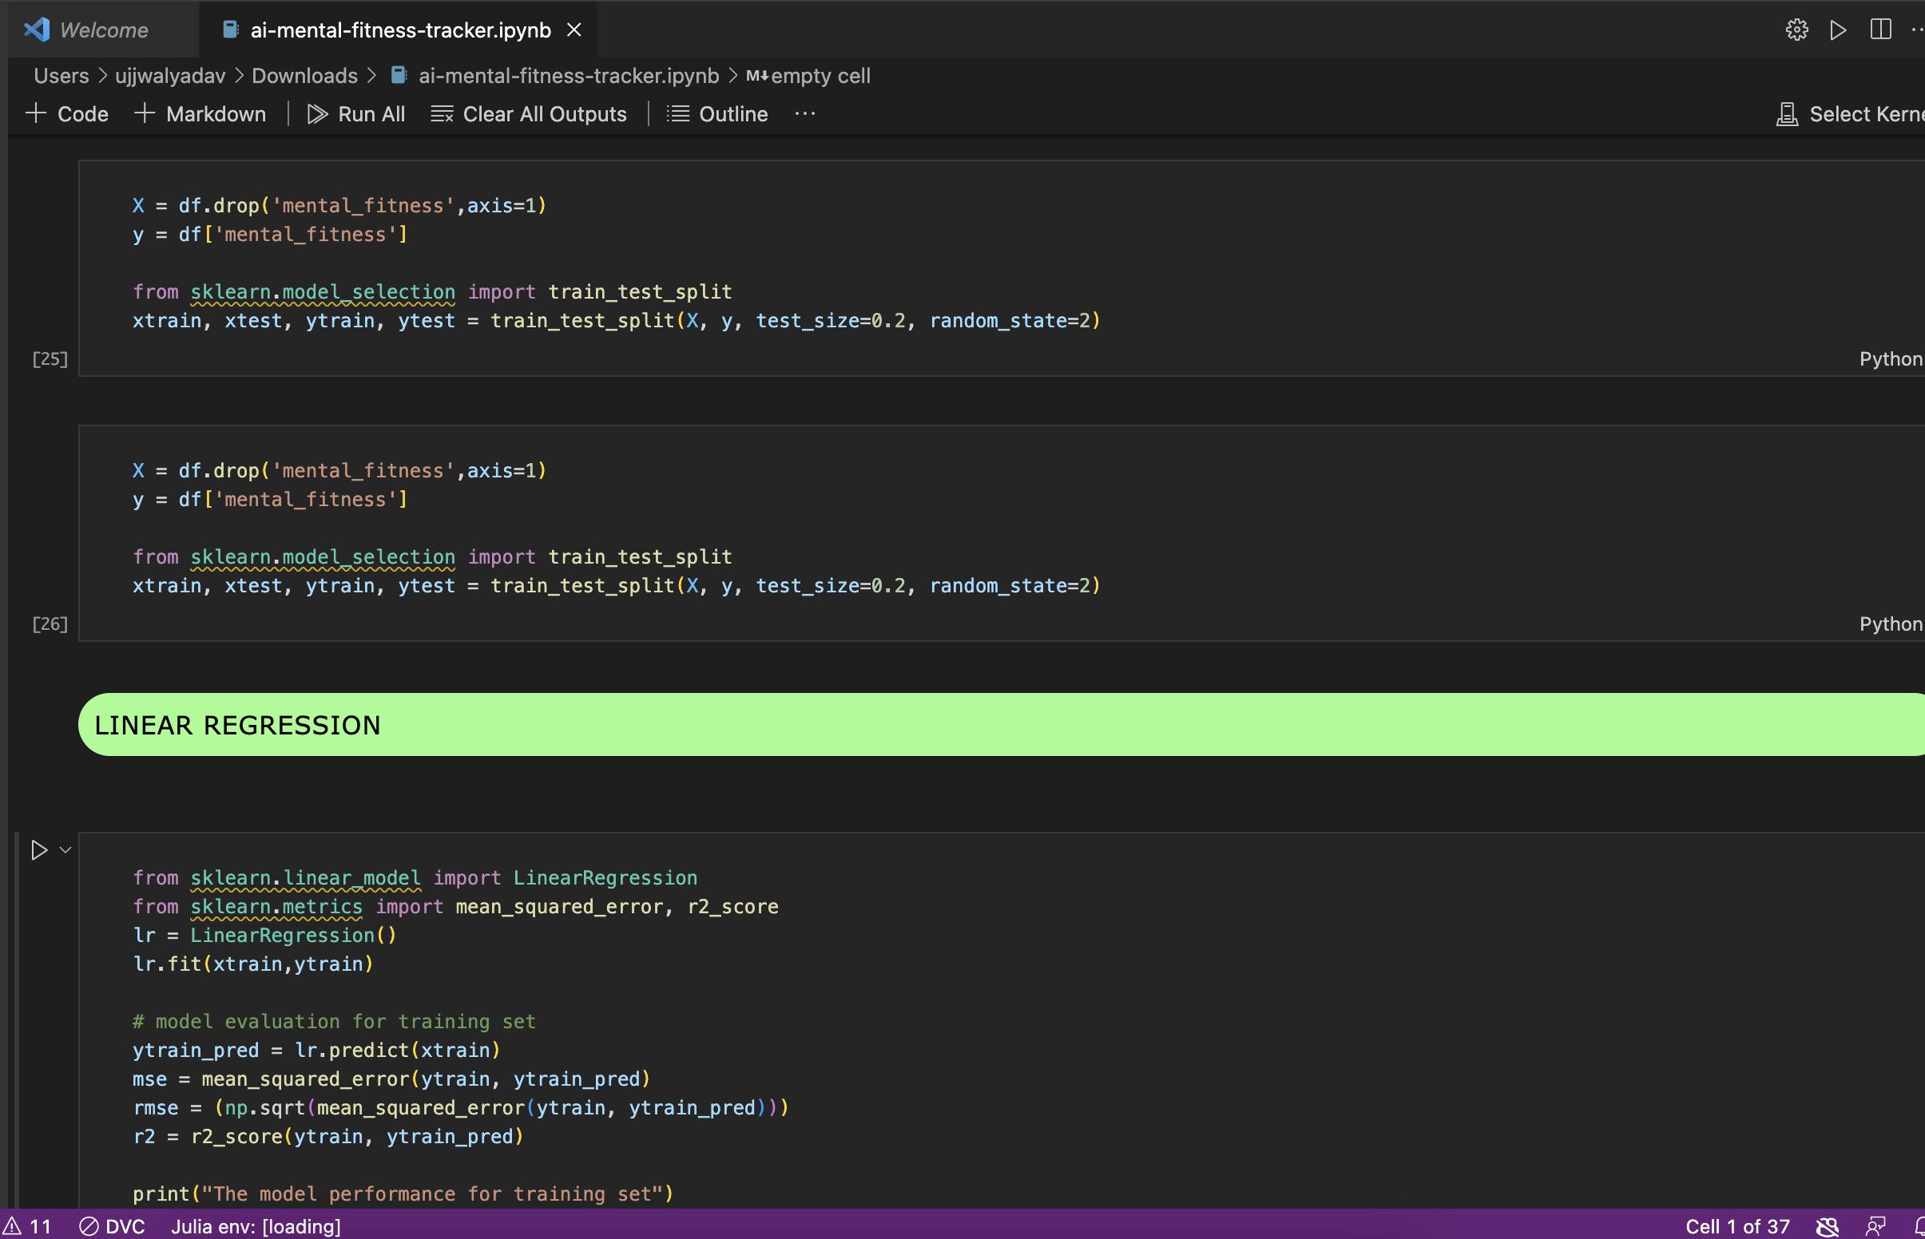
Model view

Slide 10

Result
With the help of an artificial intelligence algorithm, we can forecast a person's level of mental health. To train, the information gathered from the populace is sent. Bipolar disorder, schizophrenia, eating problems, anxiety, drug use, depression, and alcoholism The Artificial Intelligence Algorithm predicts the kind of diseases from the condition of mental health, and these are some diseases caused by mental stress.

Slide 11

Links
About AI: https://www.ibm.com/topics/artificial-intelligence
Google colab : https://colab.research.google.com/drive/1RPoPjAySC6nGcEUfvmMwAN97tJFu5EP2?usp=sharing
Github link: https://github.com/Ujjwal16y/AI-Mental-fitness-tracker.git

Slide 12
THANK YOU
z

